Slide 1


Predicting customer buying behaviour
13/03/2024

Slide 2
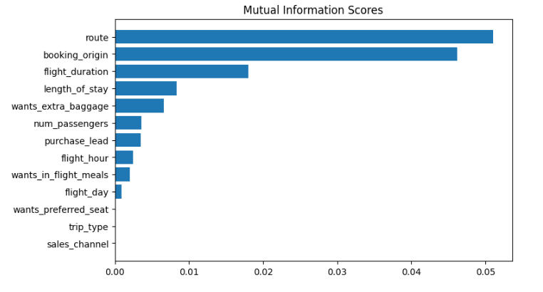
predictive model to understand factors that influence buying behaviour
We have trained the data set with Random forest classifier model and received
ACCURACY: 85.09
AUC score: 0.558
route
booking_origin
flight_duration
wants_extra_baggage
length_of_stay
are the top 5 features which influence
Customer buying behavior
We need to increase the AUC score.

